Slide 1
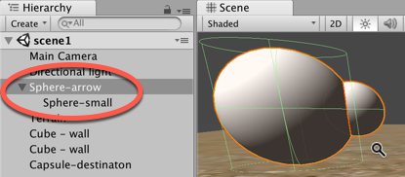
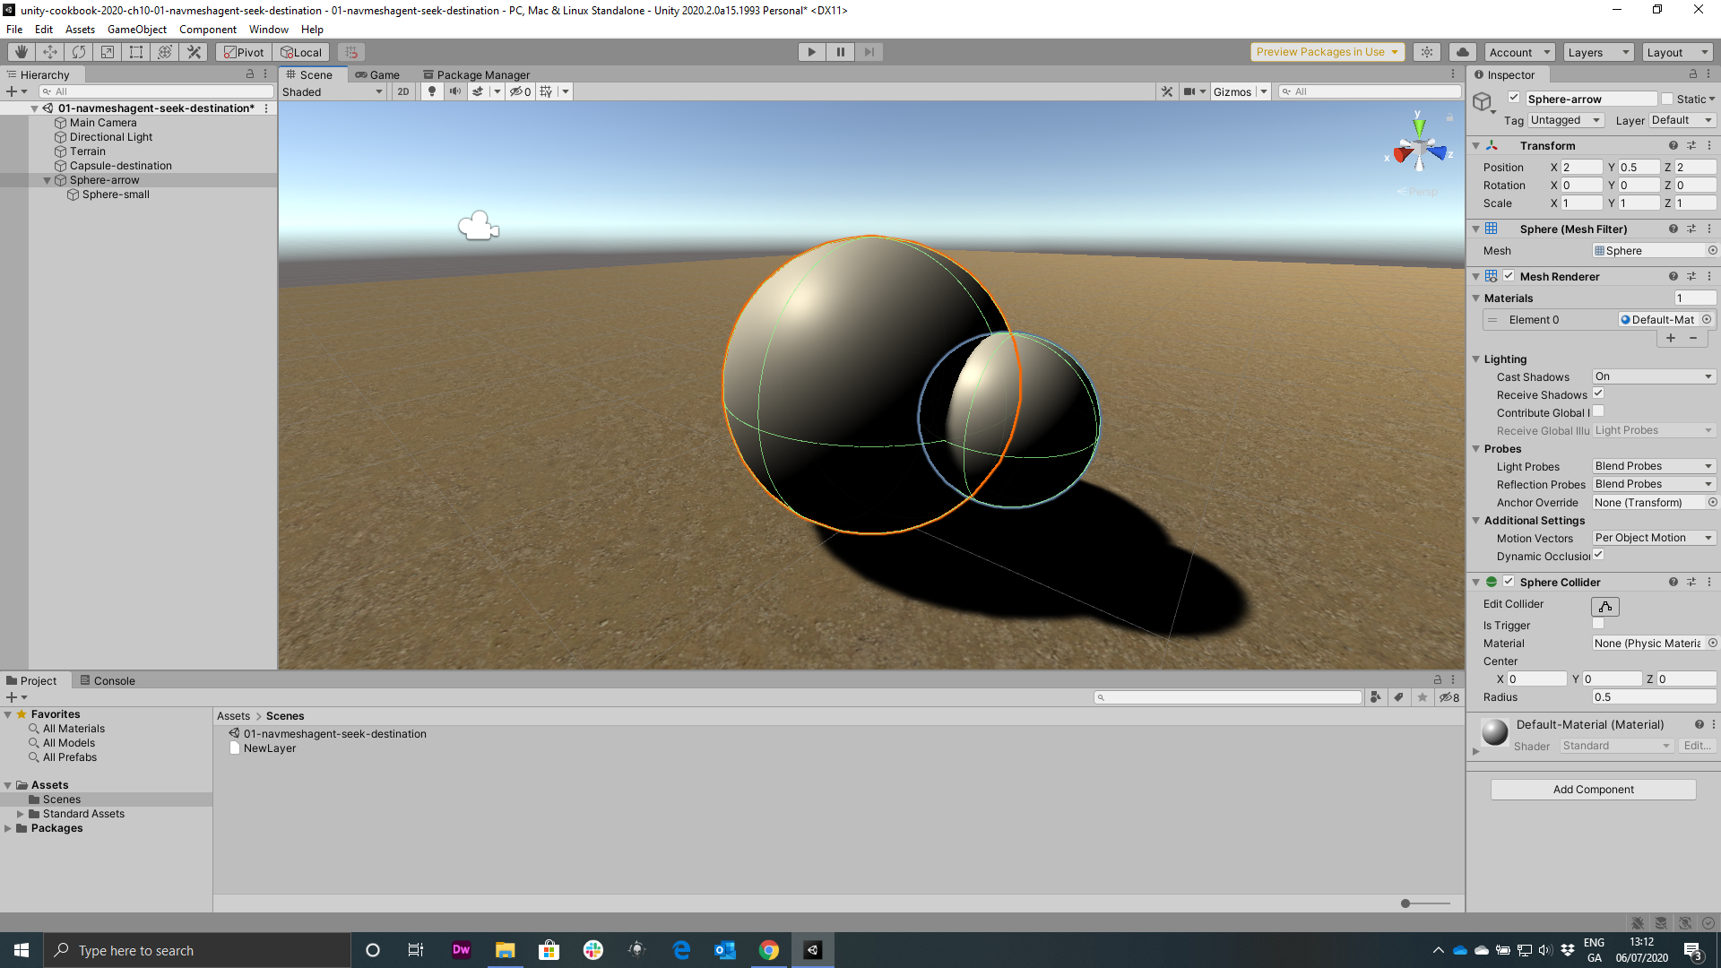
Figure 10.2: In the Hierarchy setting the Sphere-small a child of Sphere-arrow
Choose function-method
SceneLoader.LoadOnClick

Slide 2
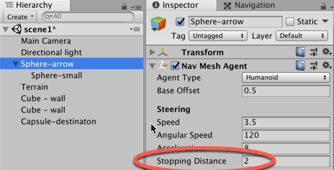
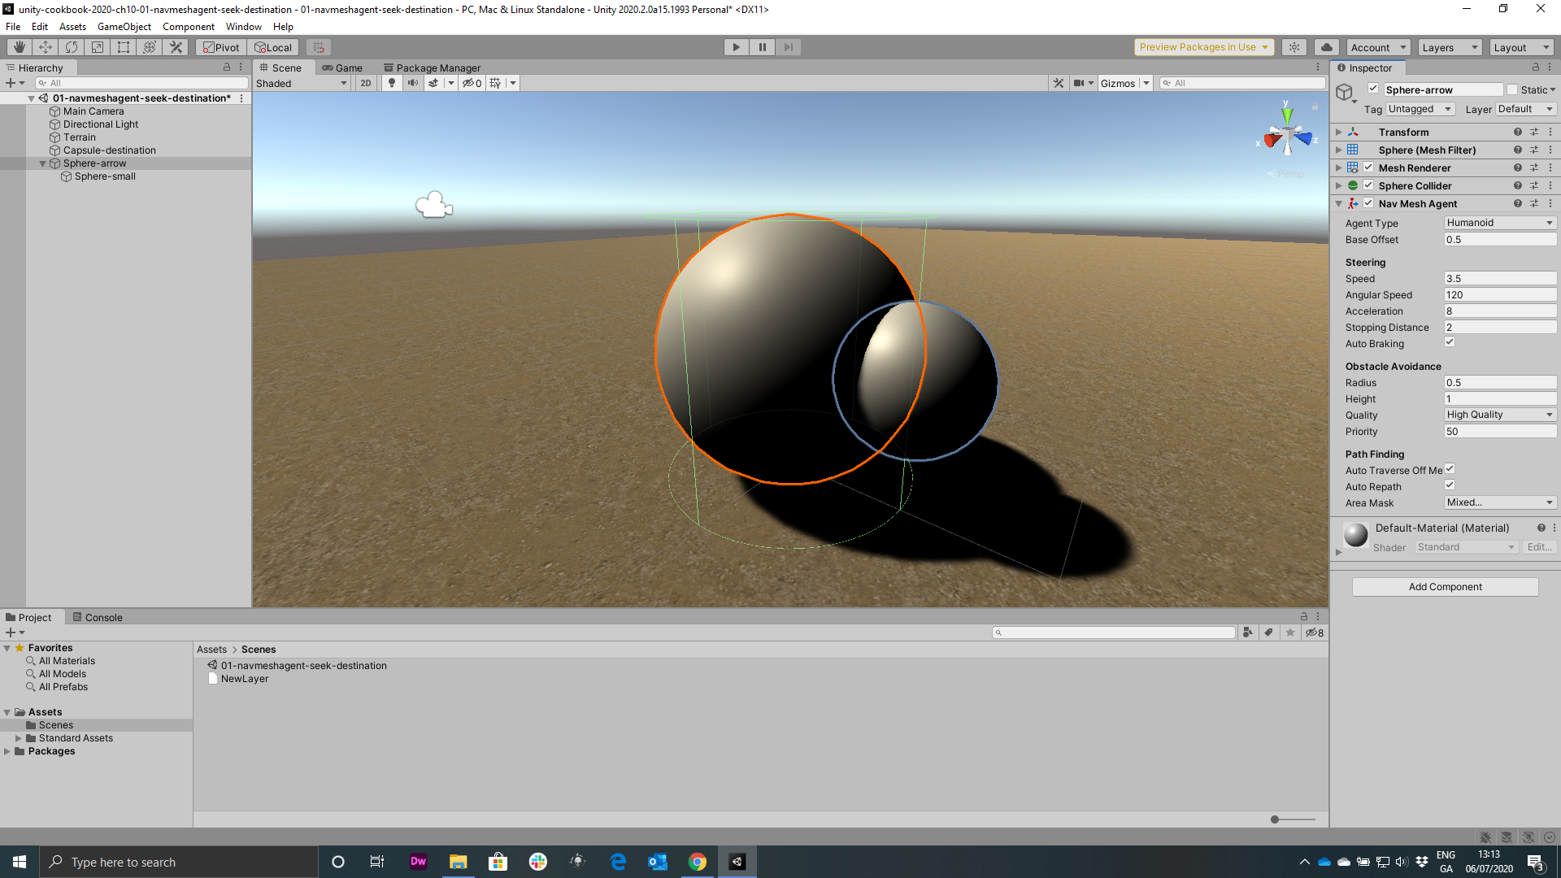
Figure 10.3: Stopping Distance property of the NavMeshAgent component to 2

Slide 3
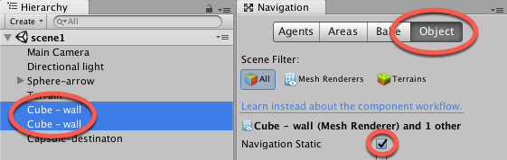
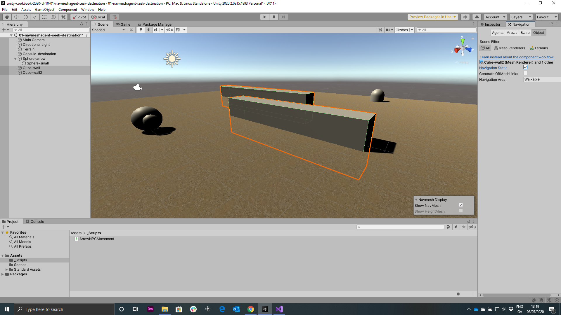
Figure 10.4: Ticking the Navigation Static checkbox for both Cube-wall objects

Slide 4
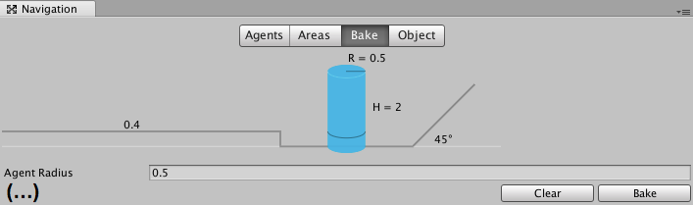
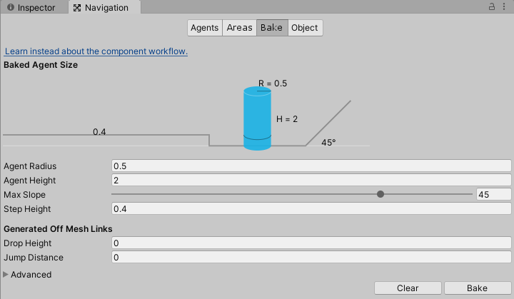
Figure 10.5: Creating the Navigation Mesh with the Bake settings

Slide 5
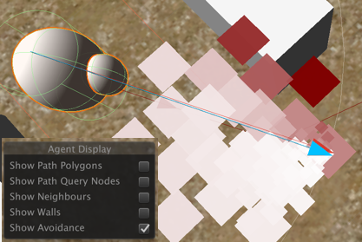
Figure 10.6: Show Avoidance Gizmo showing candidate local target positions the agent is considering

Slide 6
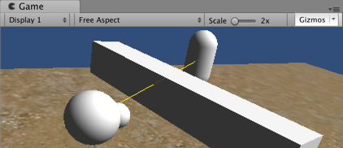
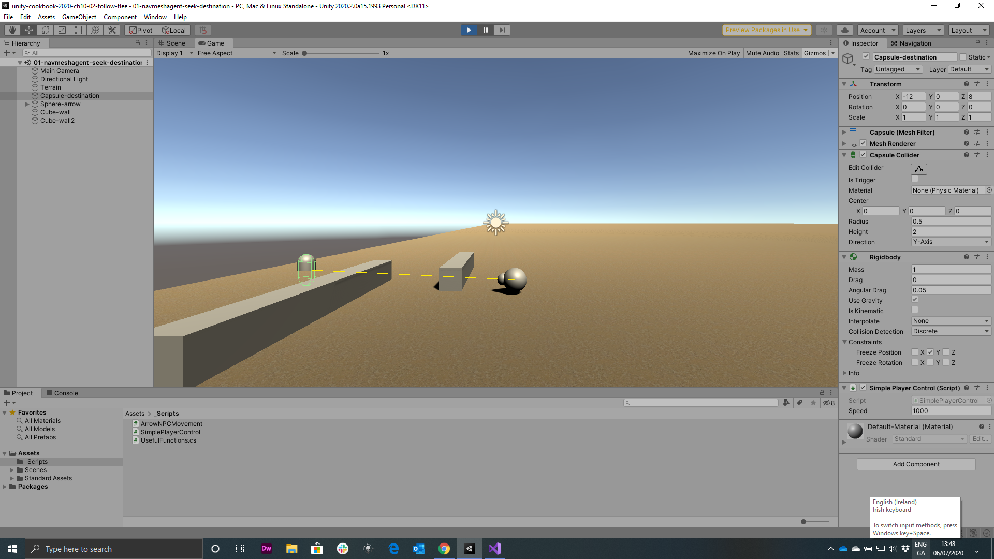
Figure 10.7: Yellow line illustrating the Debug Ray source to destination

Slide 7
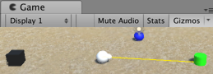
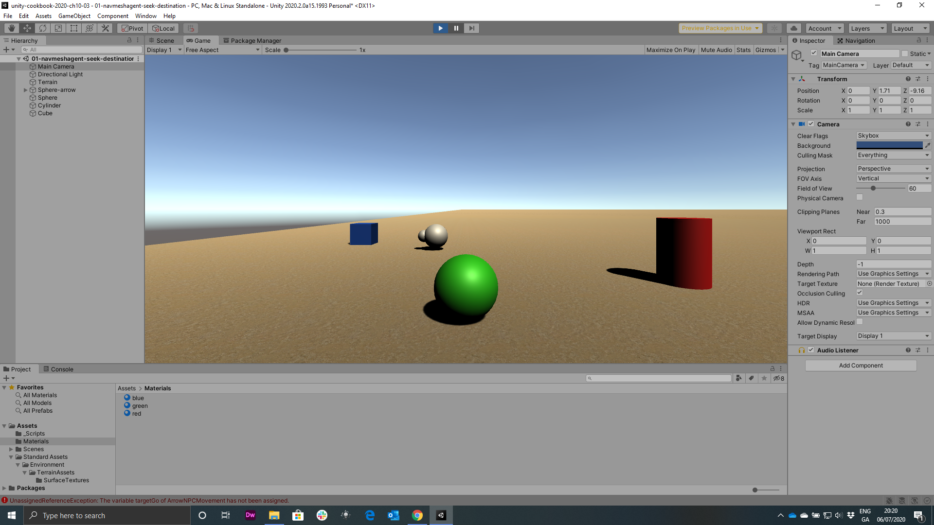
Figure 10.8: Example of point and click move to object recipe

Slide 8
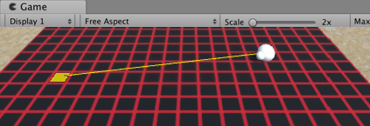
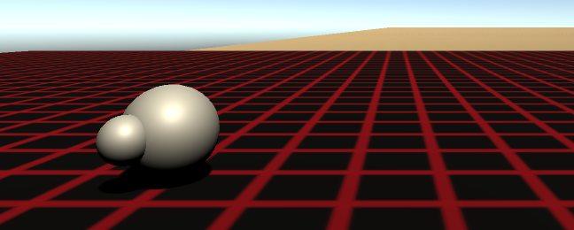
Figure 10.9: Example of point and click move to tile with 3D Plane grid

Slide 9
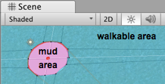
Figure 10.10: Example of recipe using Raycast and Navigation Areas

Slide 10
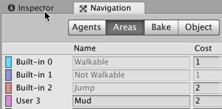
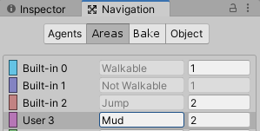
Figure 10.11: Defining Mud as a NavMesh area

Slide 11
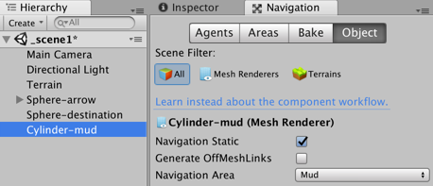
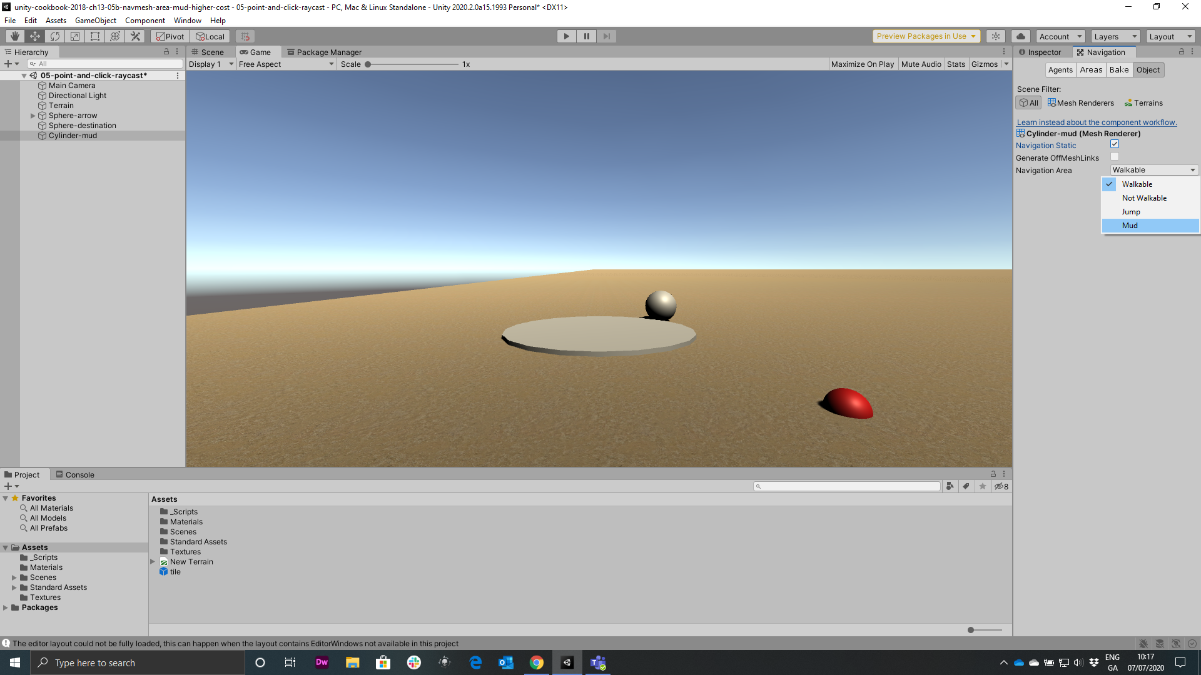
Figure 10.12: Setting the Mud as the Navigation Area in the Navigation Panel

Slide 12
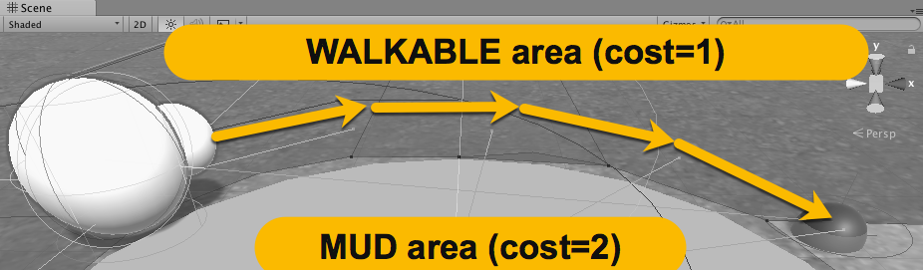
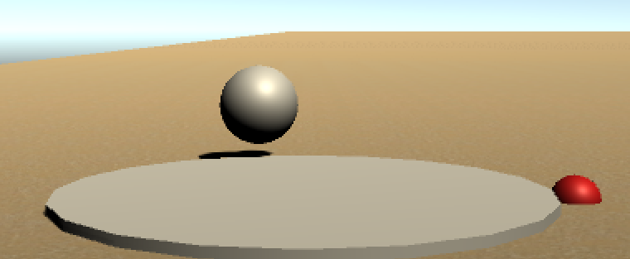
Figure 10.12: Path of Sphere-arrow GameObject bypassing the high-cost mud area
Walkable area (cost=1)
Mud area (cost=2)

Slide 13
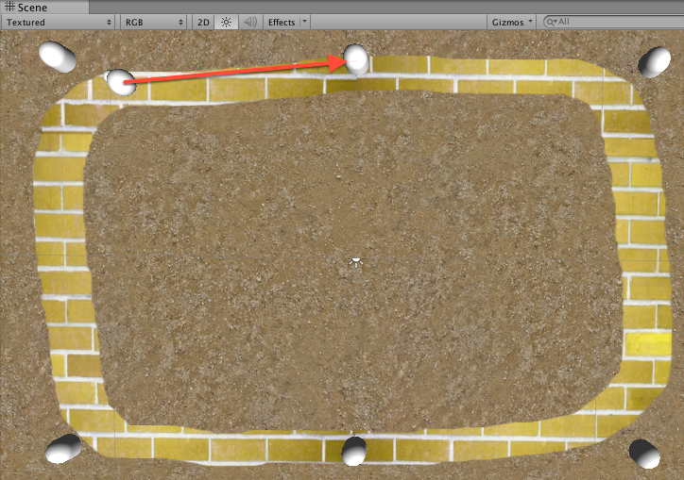
Figure 10.13: Example of recipe with 6 waypoints along a "yellow brick road"

Slide 14
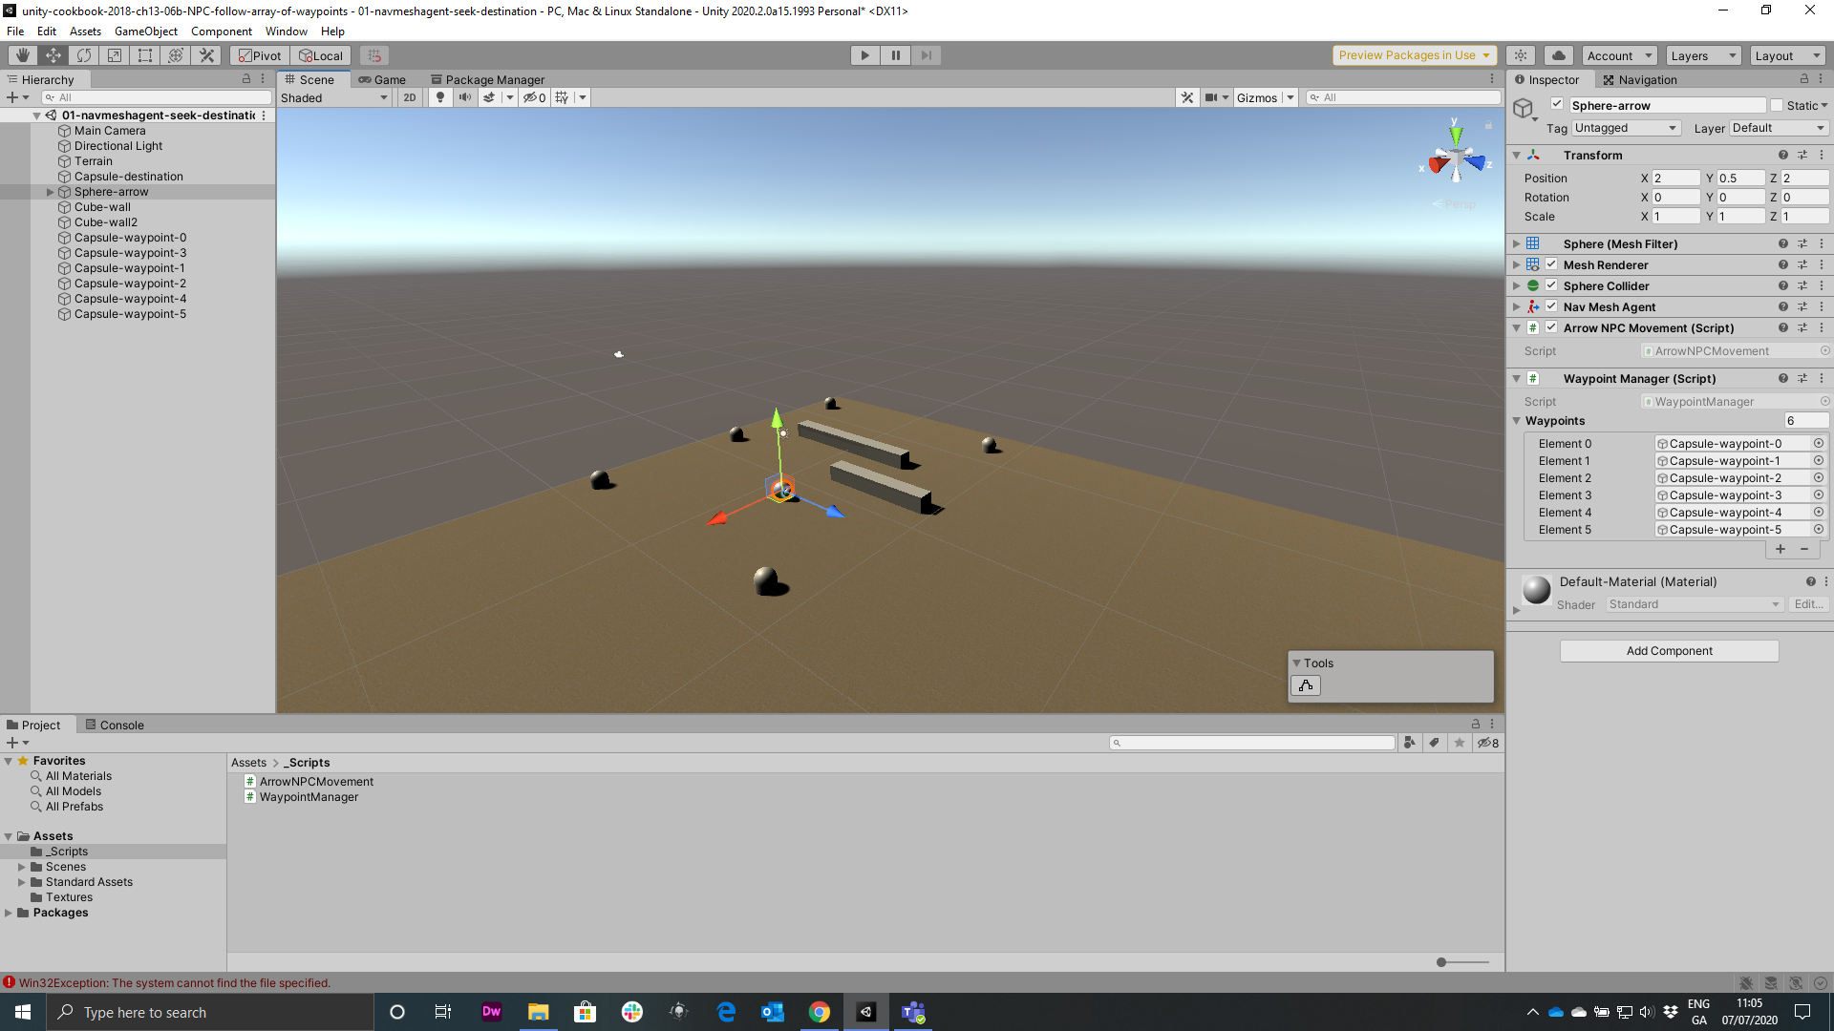
Figure 10.14: Position of waypoints to create a rectangular path

Slide 15
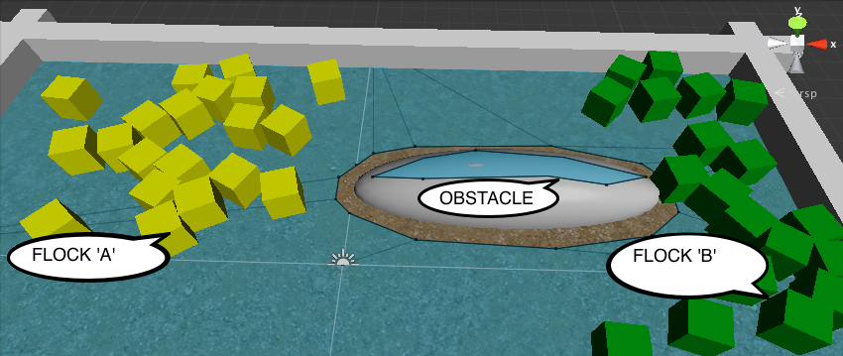
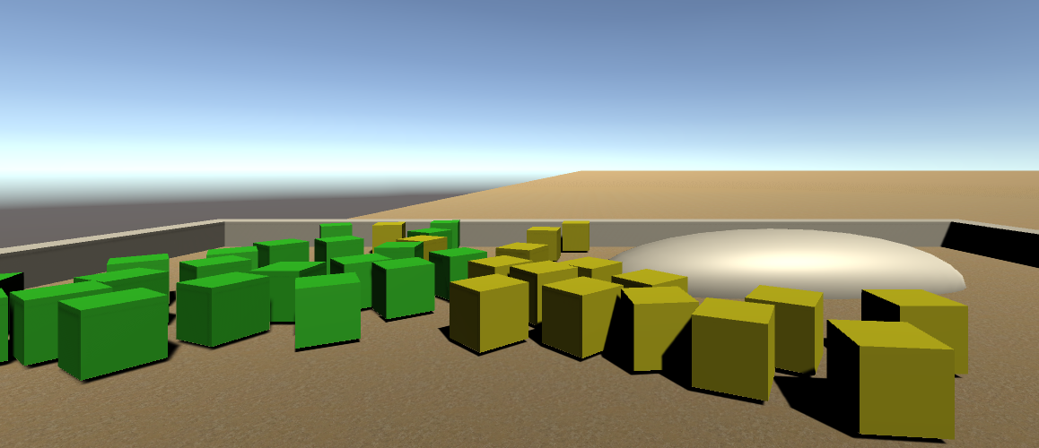
Figure 10.15: Example of Recipe, controlling object group movement through flocking
Flock ‘B’
OBSTACLE
Flock ‘A’

Slide 16
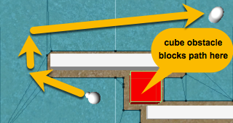
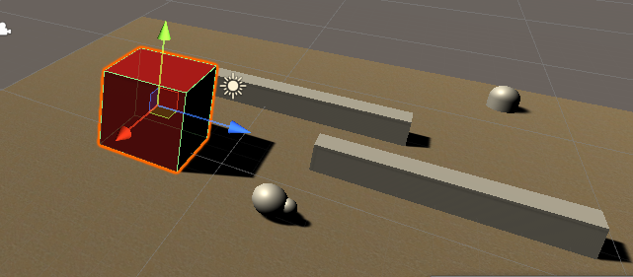
Figure 10.16: Example of recipe, red cube blocking the path of the AI NavMeshAgent
cube obstacle blocks path here

